Slide 1
Flight Ticket Price Predictor Comparison of Two Regression ML techniques
Group No 35
EG/2020/3977 Jathusan U.
EG/2020/4207 Senevirathna G.D.I.U.

Slide 2
CONTENTS
ABOUT US
INTRODUCTION
BACKGROUND
PROCESS FLOWCHART
METHODOLOGY
MODEL EVALUATION
CONCLUSION
ETHICS
Q&A

Slide 3


ABOUT US
EG/2020/3977 EG/2020/4207
Jathusan U. Senevirathna G.D.I.U.

Slide 4
INTRODUCTION
Comparing two regression analysis ML methods
We design our group project on par with the Machine Learning (EE5253) module of the 5th semester.
We have selected the regression ML methods to compare and conclude the best algorithm for the given problem statement.
We have developed two ML models using Jupiter python libraries.
We have tested both the models and compare the accuracy of each.
Finally, we have come to the conclusion based on the results we got.
Further we can develop the scope of our project in future needs.

Slide 5
BACKGROUND
Flight ticket prediction using regression
Predicting the price of a flight ticket is challenging due to various factors, including demand, supply, seasonal variations, and competitor pricing.
Predicting airfares with accuracy is crucial as it has advantages for both airlines and passengers.
Travelers can find the most affordable airfare rates, and airlines can enhance their pricing strategies to maximize their revenue.
It will be useful in future predictions and related researches in airline sector.

Slide 6
PROCESS FLOWCHART steps of the process
Step 2
Step 4
Data Collection
Building Algorithm models
Determine the Accuracy
Data Preprocessing
Apply model for Prediction
Step 1
Step 3
Step 5

Slide 7
METHODOLOGY
Divided into four sections namely,
1. ML Problem
2. Data
3. Algorithm
4. Modelling

Slide 8
1. ML Problem
Flight Ticket Price Prediction
Task(T): To estimate the price of airfare by taking into consideration several parameters like the airline, date, time, and location of departure and arrival, among other relevant details.
Experience (E): The experience is based on historical airline price data, which includes specifics on previous routes, dates, hours, and related contextual information.
Performance Measure (P): The model's ability to forecast actual airplane ticket prices based on the features it is given. This accuracy is often expressed as measures such as mean absolute error or root mean square error.

Slide 9
2. Data
Data source: https://www.kaggle.com/datasets/shubhambathwal/flight-price-prediction/
Features in data set : ‘Unnamed:0’, airline', 'flight', 'source_city', 'departure_time', 'stops', 'arrival_time', 'destination_city', 'class', 'duration', 'days_left', 'price’
Number of Columns in data set : 12
Number of examples in data set: 300153
Output Variable :- Ticket Price

Slide 10
3. Algorithm
The algorithms will be used in the project.
1: Linear Regression
2: Decision Trees
Both linear regression and decision trees algorithms are available as off-the-shelf algorithms from the scikit-learn library in Python.

Slide 11
4. Modelling
This is the step-by-step process to achieve the test results including ,
Data pre-processing
Creating Algorithm Models

Slide 12
Data preprocessing
Drop unwanted columns.
Check missing values.
Encode the categorical data.
Correlation
Cross Validation
Hyperparameter Tuning

Slide 13
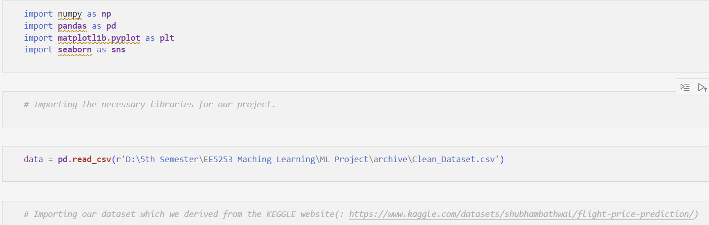
Data preprocessing

Slide 14
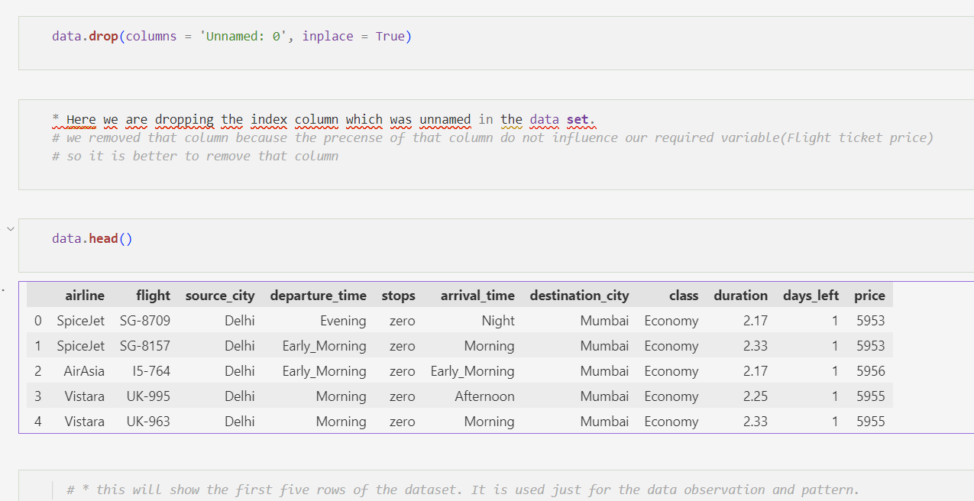
Data preprocessing
1. Drop unwanted columns.

Slide 15
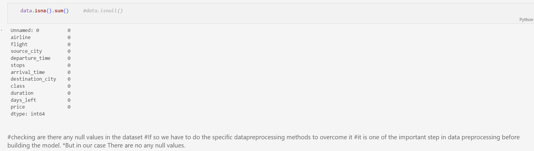
Data preprocessing
2. Check missing values.

Slide 16
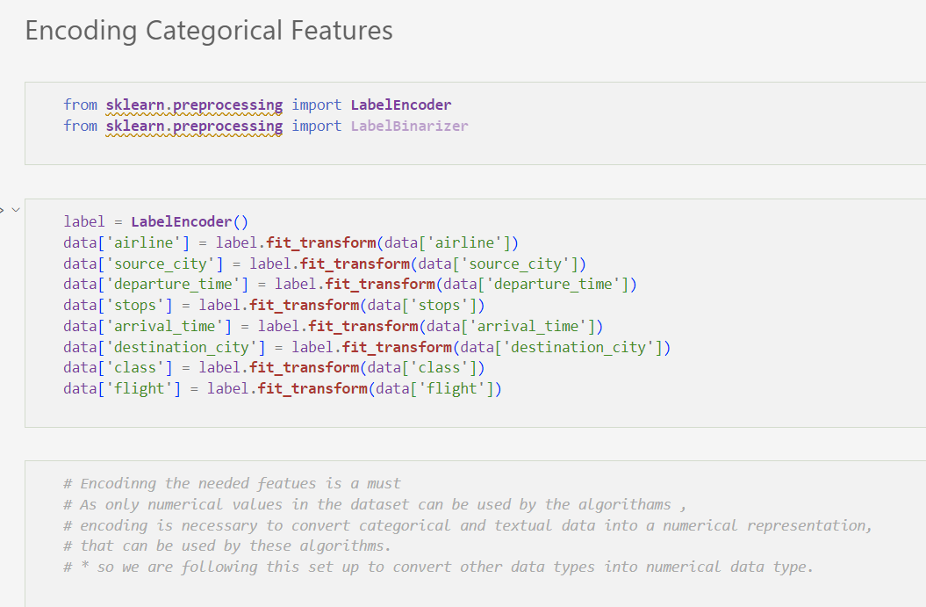
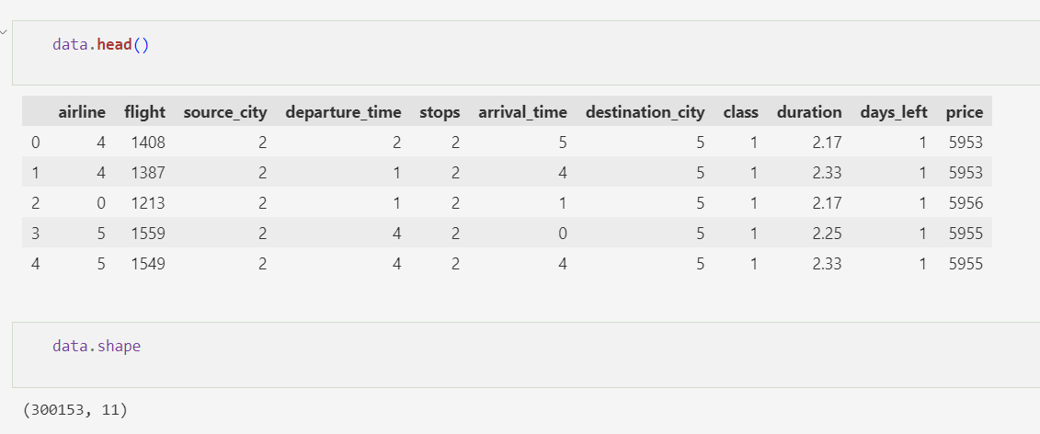
Data preprocessing
3. Encode the categorical data.

Slide 17
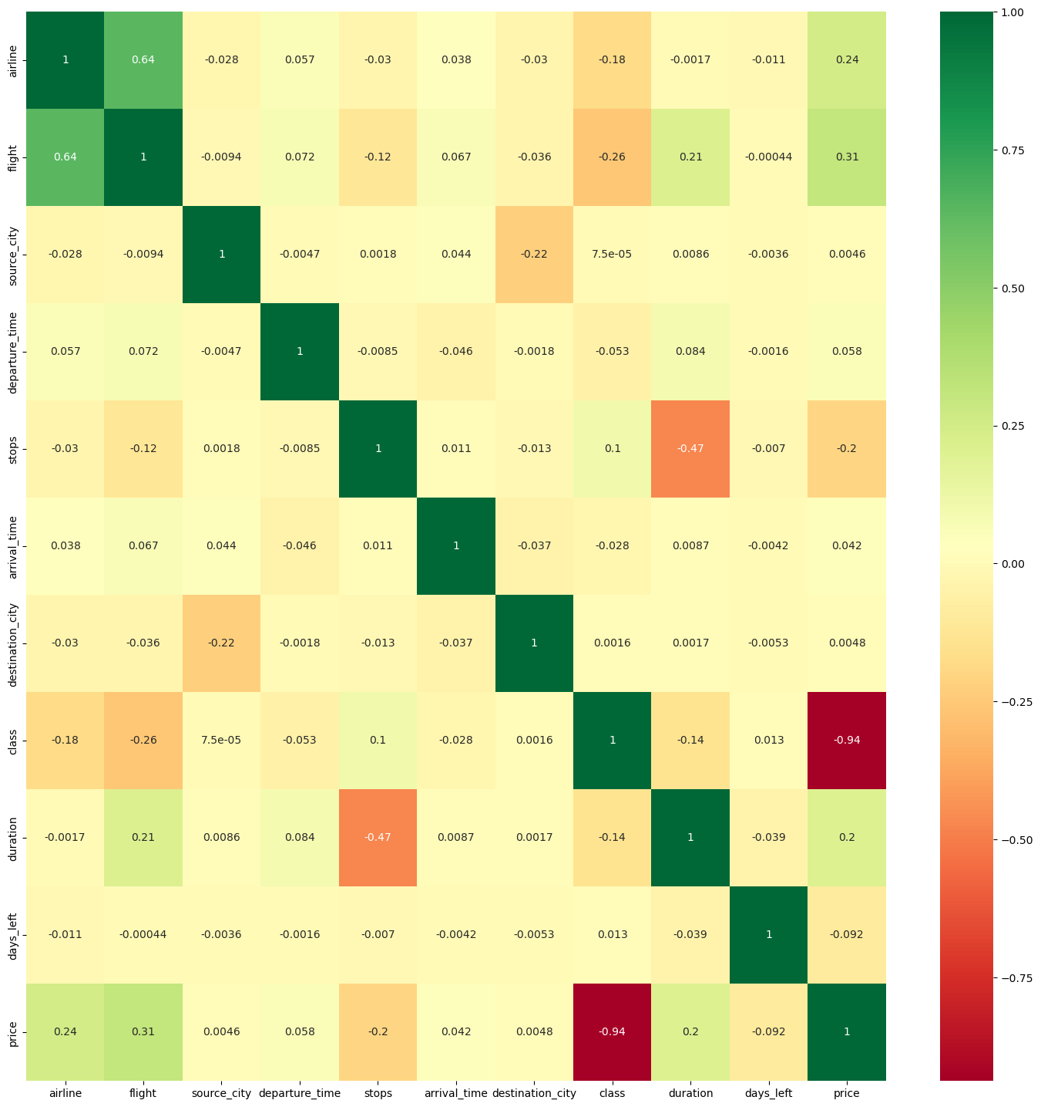
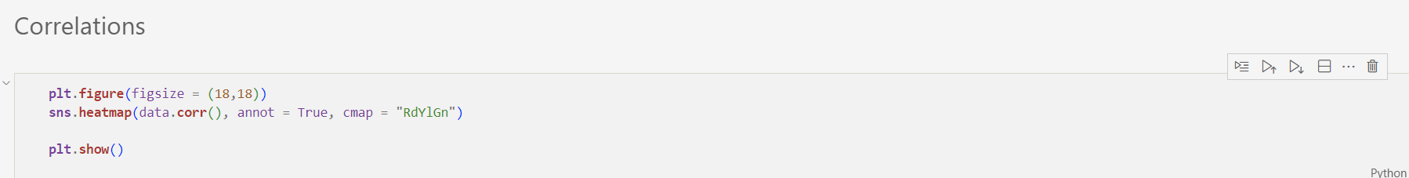
Data preprocessing
4. correlation

Slide 18
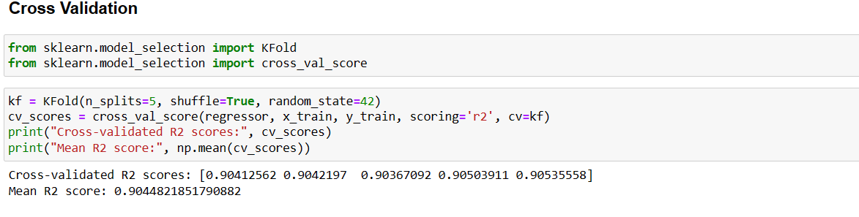
Data preprocessing
5. Cross Validation

Slide 19
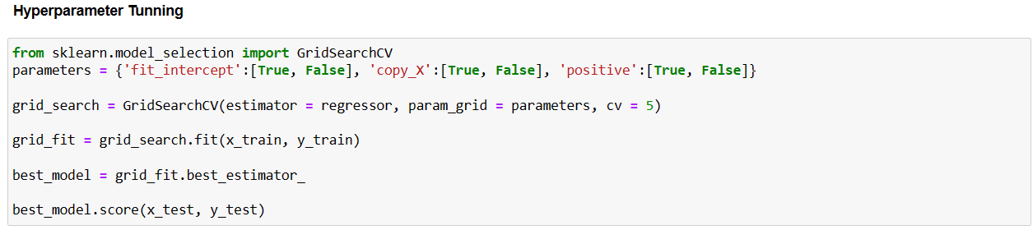
Data preprocessing
6. Hyperparameter Tuning

Slide 20
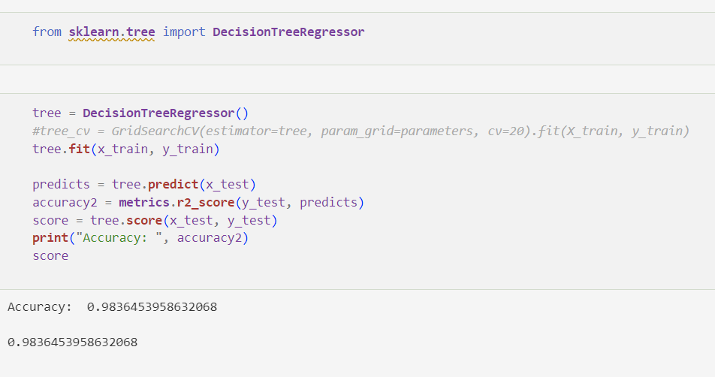
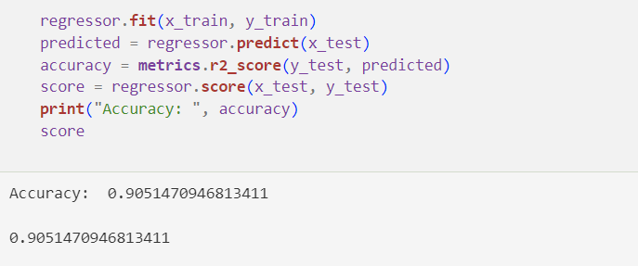
Machine Learning Models
1. Linear regression 2. Decision Trees

Slide 21
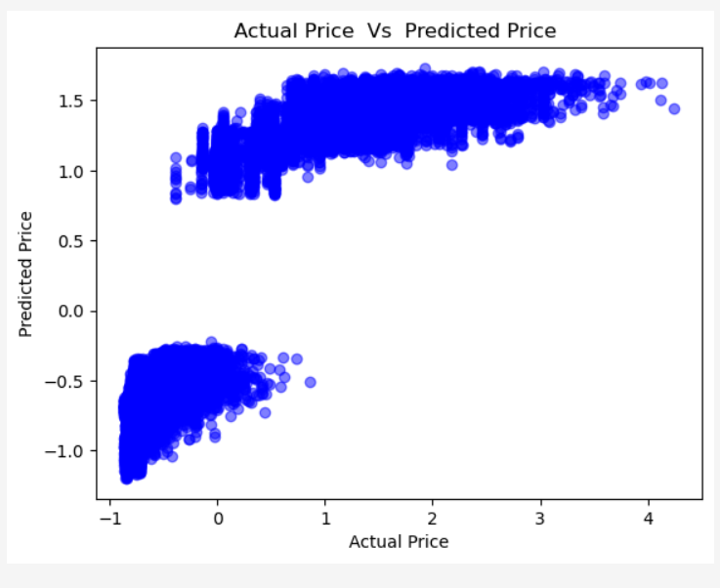
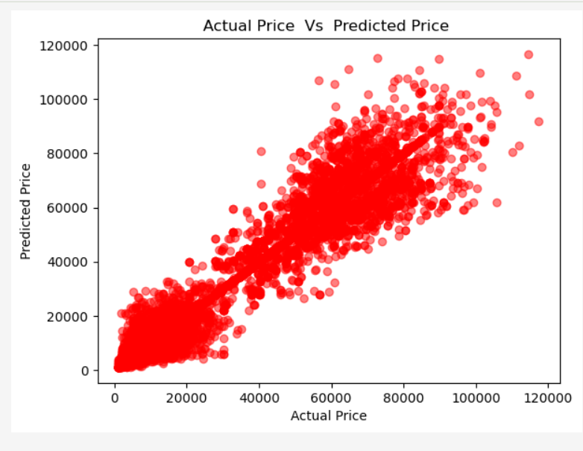
MODEL EVALUATION
Linear regression Decision Trees
Accuracy: 0.90514
Mean Absolute Error: 0.204667
Accuracy: 0.98364
Mean Absolute Error: 0.03898

Slide 22
CONCLUSION
The decision tree model outperforms the linear regression model in terms of accuracy. The decision tree has an accuracy of 0.98364, indicating that it correctly predicts the target variable in approximately 98.36% of cases. In contrast, the linear regression model has an accuracy of 0.90514, which is still reasonably high but lower compared to the decision tree.
The choice between these models might depend on the specific goals of our task. If accurate classification is crucial, the decision tree might be preferred. If precise prediction of continuous values is more important, the linear regression model might be the better choice.

Slide 23
ETHICS
Ethical aspects dealing with the project
Privacy Concerns
Fairness and Bias
Transparency
Security
Accountability
User Consent
Data Source Validity

Slide 24
Q&A

